Slide 1

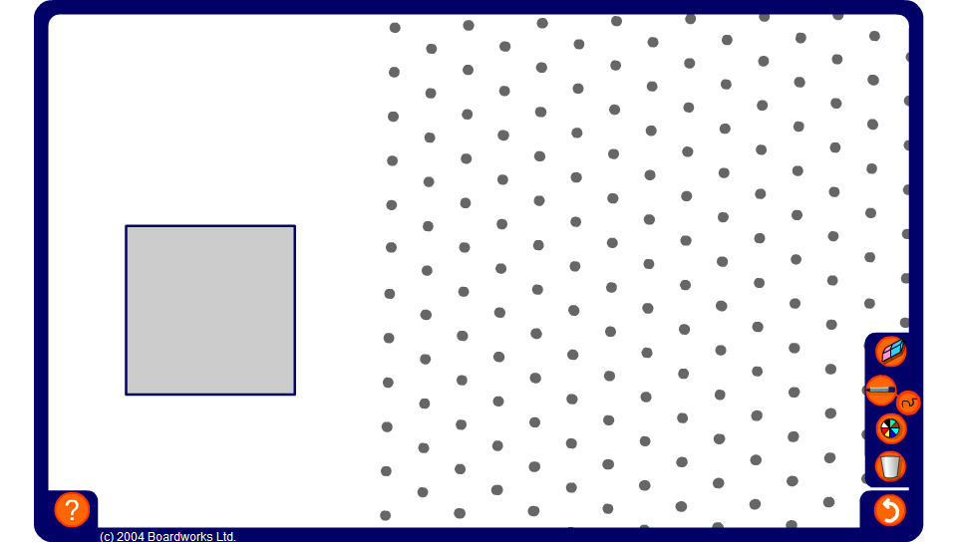


Drawing shapes from plans
Notes:
Ask a volunteer to draw the solid shown in the plan on the isometric grid. Use the pen tool, set to draw straight lines.
Pupils may wish to build the shape first using interlocking cubes.

